Slide 1
Cloud Service Technology Project Hosting Serverless Website in AWS
Shailendra Kushwaha

Slide 2
Topics
Introduction
AWS Overview
Identity Access Management
S3 (Simple Storage Services) in AWS
CDN
Lambda Function
API Gateway

Slide 3
Introduction to project
Main purpose to host Serverless webpages using AWS services
Used main services of AWS: S3, EC2, Lambda, API gateway, CDN
These are core services of high level services Security, Identity and Compliance and Compute

Slide 4
History of AWS
2003-First paper on Amazon Internal Architecture Presented
2006-AWS officially launced targeting Silicon Valley startups
2010-Amazon.com moved to AWS
2004-SQS a messaging service launched as first AWS service
2007-Gained 180,000 developers to platform
2012-First re-invent conference
2013-Certifications Launched to generate Certified people for businesses using AWS
2015-Breaked revenue to $6 billion USD
2017-Launched AI Services
2018-Launced Machines learning services
2019-Alexa beta services is launced

Slide 5
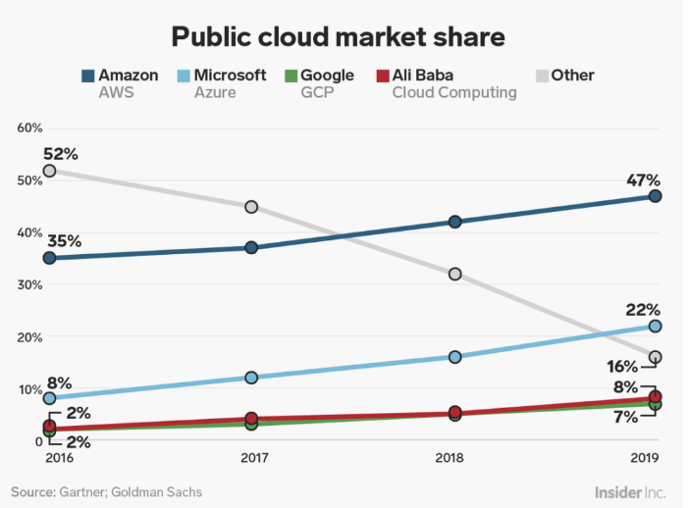
Market Share by AWS
Bezos has said,”AWS had the ususual advantage of a seven-year head start before facing like-minded competiton. As a result, the AWS services are by far the most evolved and most functionality-rich.”

Slide 6
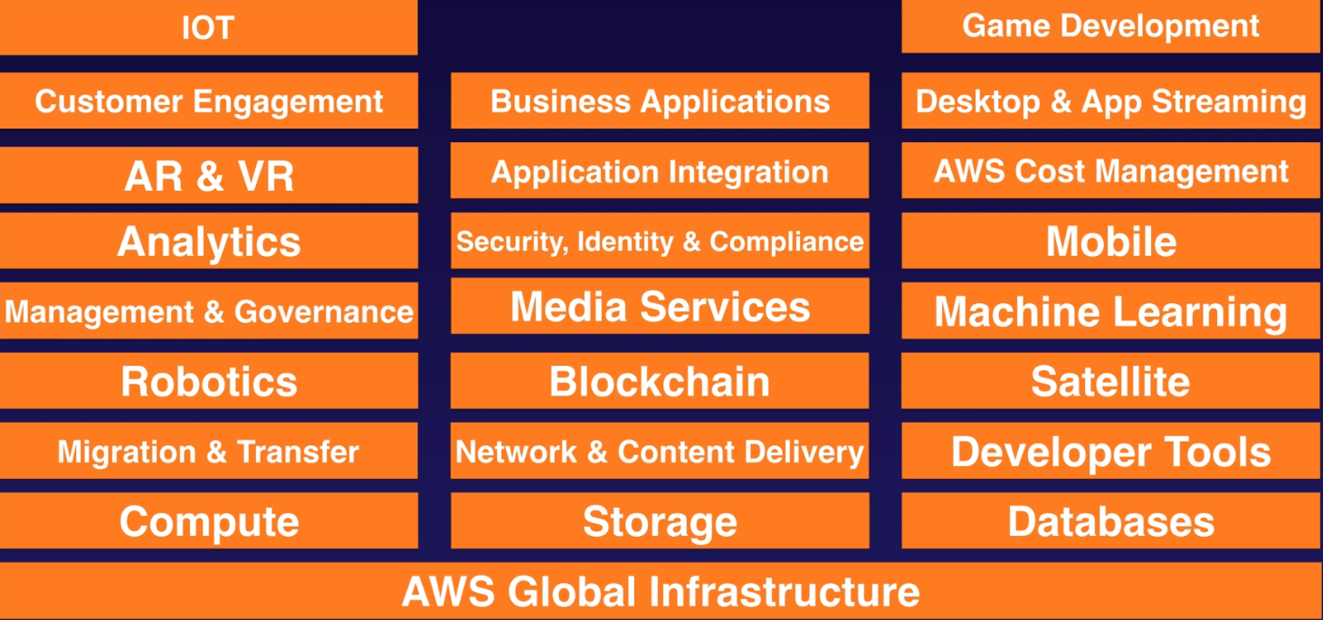
Services by AWS

Slide 7
AWS Global Infrastructure
Regions – It is a physical location in the world which consists of two or more AZ.
Availability Zones(AZ) – It is one or more discrete data centres, each with redundant power, networking and connectivity, housed in separate facilities.
Edge Locations – They are end points for AWS which are used for caching content. Typically this consists of CloudFront, Amazon’s Content Delivery Network (CDN).
Serving million of users in more than 190 countries
Having 20+ Regions, 60+ Availability Zones (AZ) and 155+ Edge locations
Expansion purpose is to meet global requirement as per customer business grow in different geographical areas
Each Region completely isolated from another for fault tolerance and scability
To deliver most flexible, reliable, scalable, and secure cloud computing environment with highest quality of global network performance

Slide 8
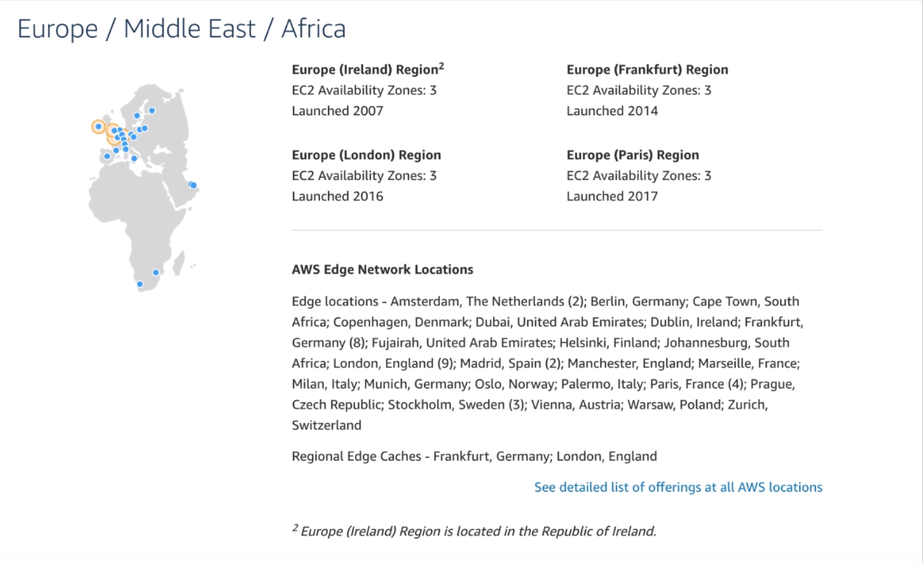
Regions, AZ and Edge Location

Slide 9
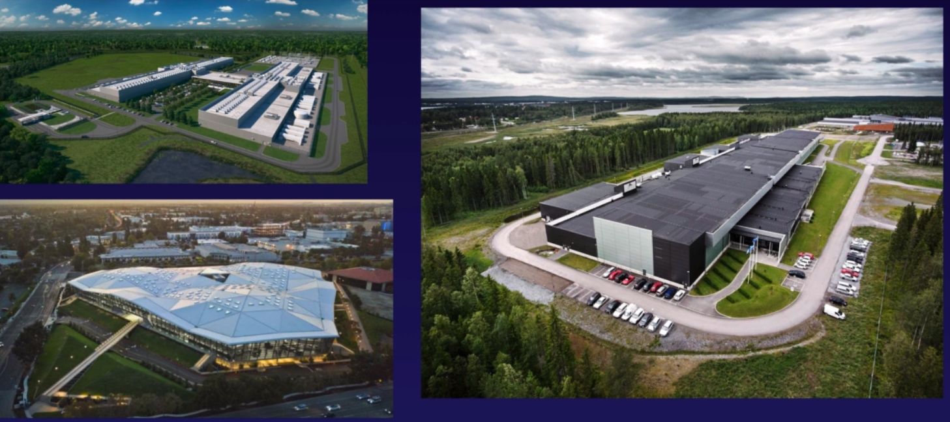
Availability Zones (AZ) : Basically Data Centers

Slide 10
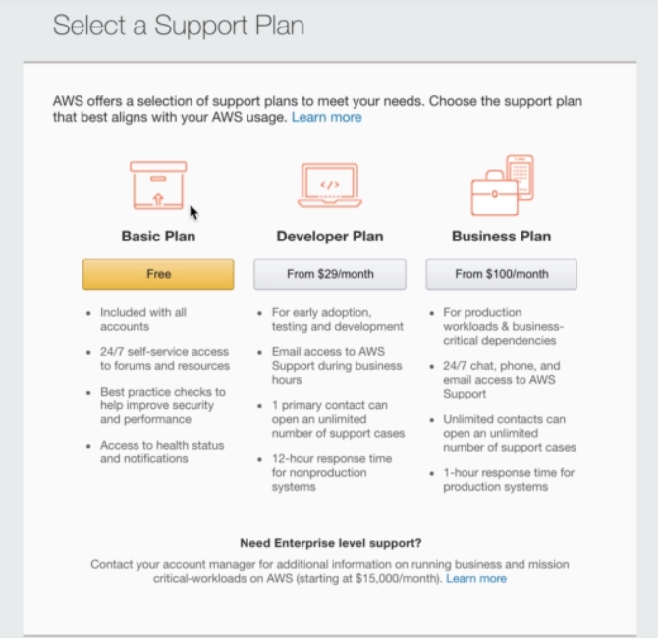
Support Plans for Users

Slide 11
IAM (Identity Access Management)
Allows to manage users in company’s to set setup their roles and permissions
Centralized contol of our AWS account
Granular permission with defined permissions for users to access specific services
Identity Federation ( Active Directory , Facebook, LinkedIn)
Multifactor Authentication
Supports PCI DSS Compliance ( a complaint framework if taking credit card details)

Slide 12
Key Terminology For IAM
Users : End users such as people, employees of an organization etc
Groups: A collection of users. Each user in the group will inherit the permissions of the group
Policies: Policies are made up of documents, called Policy documents. These documents are in a format called JSON and they give permissions as to what a User/Group/Role is able to do.
Roles: We create roles and then assigne them to AWS Resources

Slide 13
S3 (Simple Storage Sevices)
Provides secure, durable, highly scalable object storage
Object based storage – i.e allows us to upload files
Unlimited storage
Files are stored in Buckets ( also we call folders as general)
S3 has universal namespace - i.e. Names must be unique globally
Guarantees 99.99999999999% durability to stored data

Slide 14
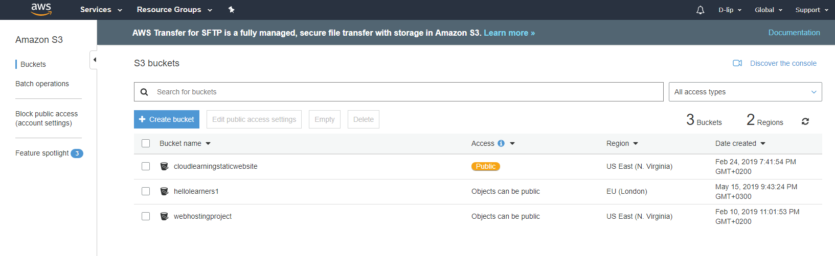
Create Bucket

Slide 15
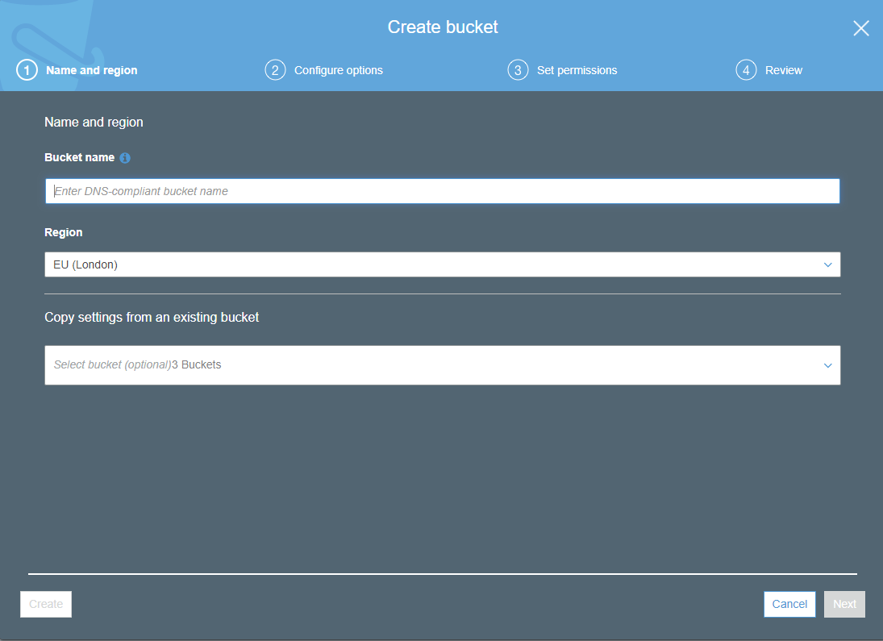
Step 1 Choose Name and Region

Slide 16
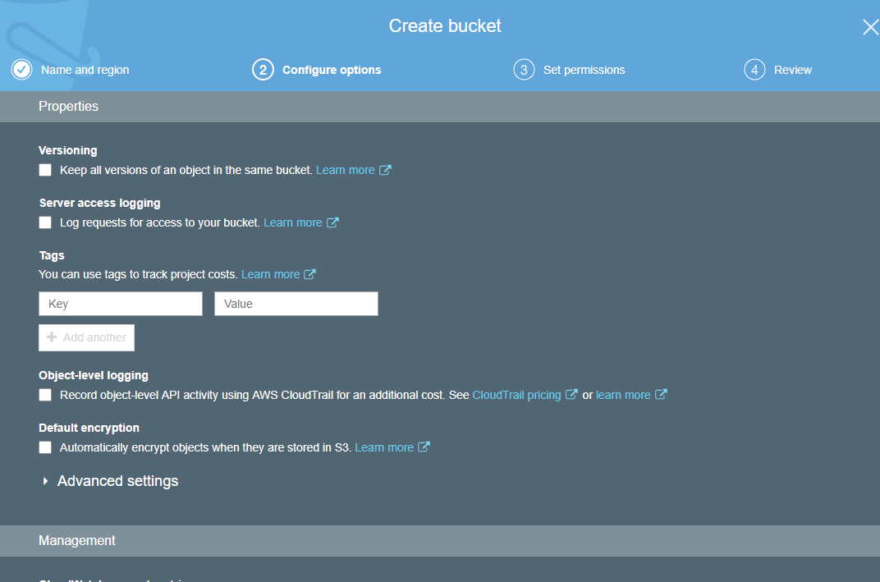
Step 2 : Configure options

Slide 17
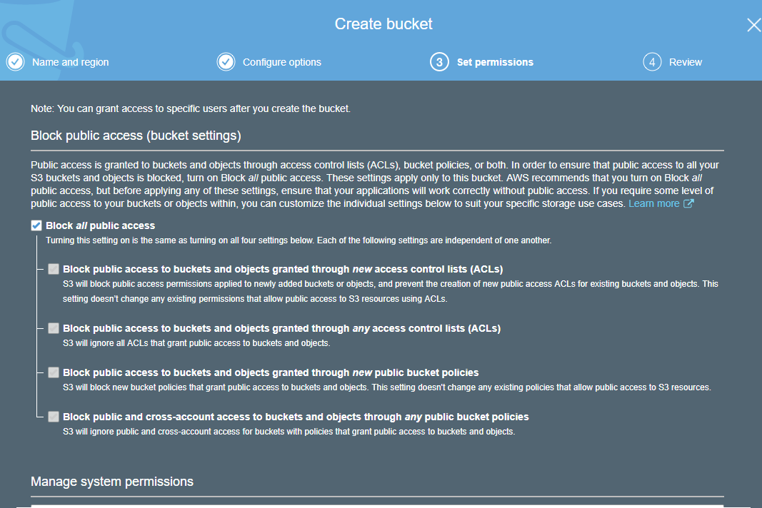
Step 3 Set Permissions

Slide 18
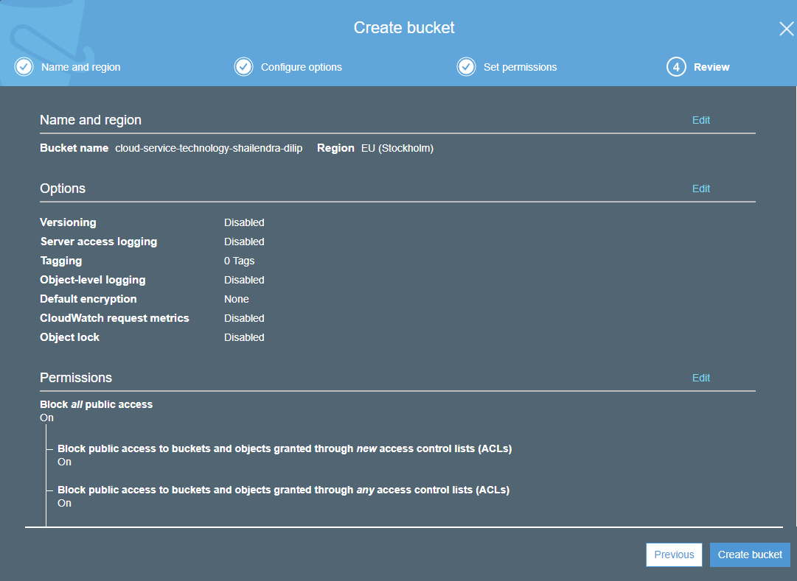
Step 4 Review

Slide 19
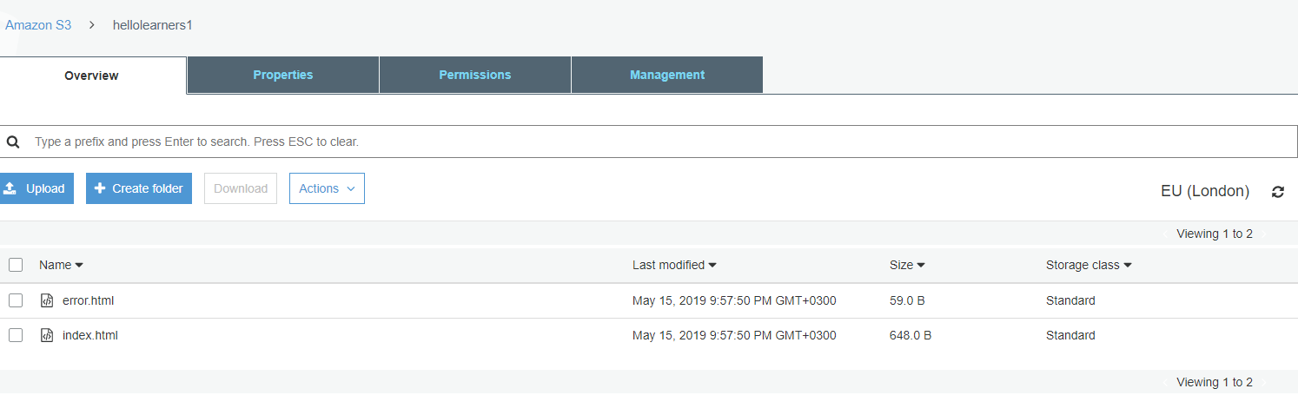
Created bucket with content

Slide 20
EC2 (Elastic Compute Cloud)
Amazon’s servie providing resizeable compute capacity in the cloud
Reduces time required to obtain and boot new server instances
Main reason for economic billing
On demand: hourly or second payment rate
Reserver: Provides capacity of reservation offering significat discount on charges with yearly terms

Slide 21
AWS Lambda
Infrastructure as a Service (IaaS)
Encapuslater (data centres, hardware, assembly code/protocols, OS)
Self scaling e.g Scaling up RAM from 4 gigs to 8 gigs
Serverless website hosting tool

Slide 22
Hosting Serverless Website using Lambda
Step 1: Lambda Function Creation Using Python
Step 2: API Gateway deploy ( to administrate APIs)
Step 3: Get method declared (default methods are not secured)
Step 4: Create Bucket ( to store our file) which contain the link URL of our Lambda deployed function
Step 5: Lauch page and configure Bucket for public access

Slide 23
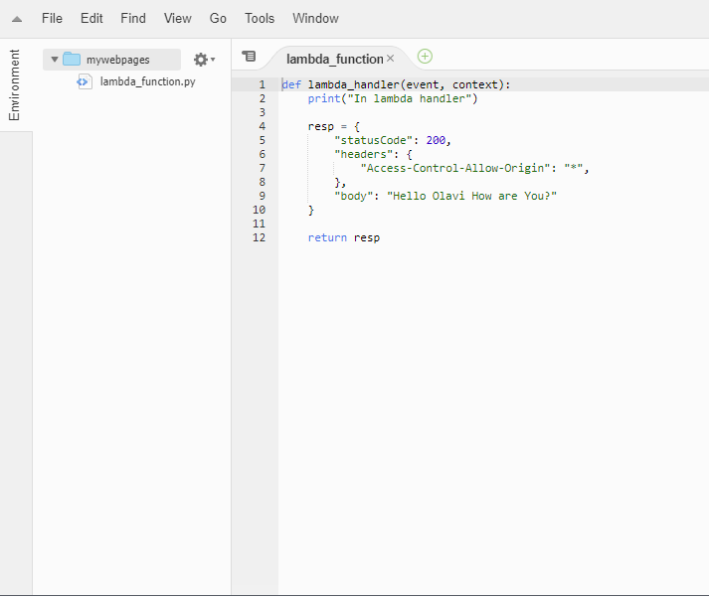
Lambda Function Code

Slide 24
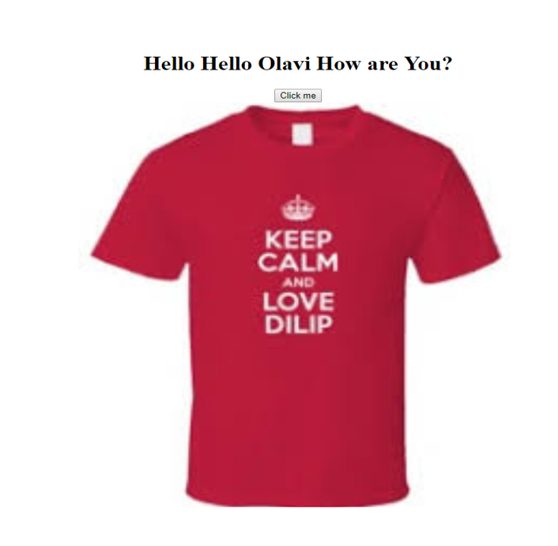
Webpage on Browser

Slide 25

Thank you !!

